Slide 1
2D graphics Portfolio
-Song . Seungheon

Slide 2
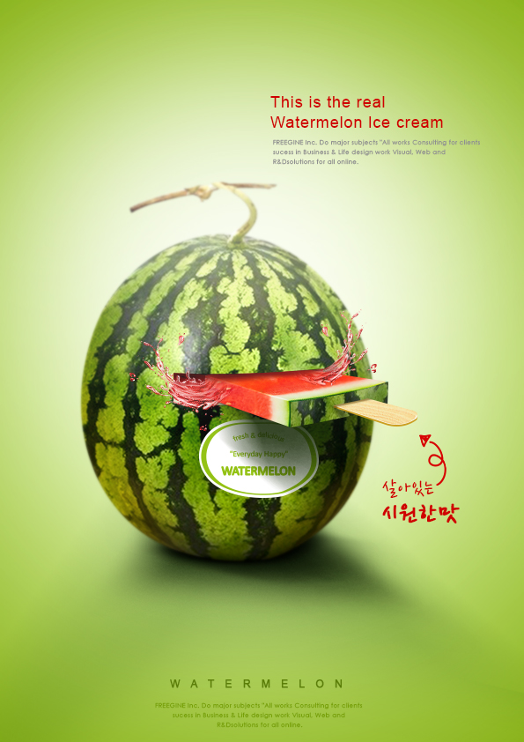

Slide 3


Slide 4


Slide 5
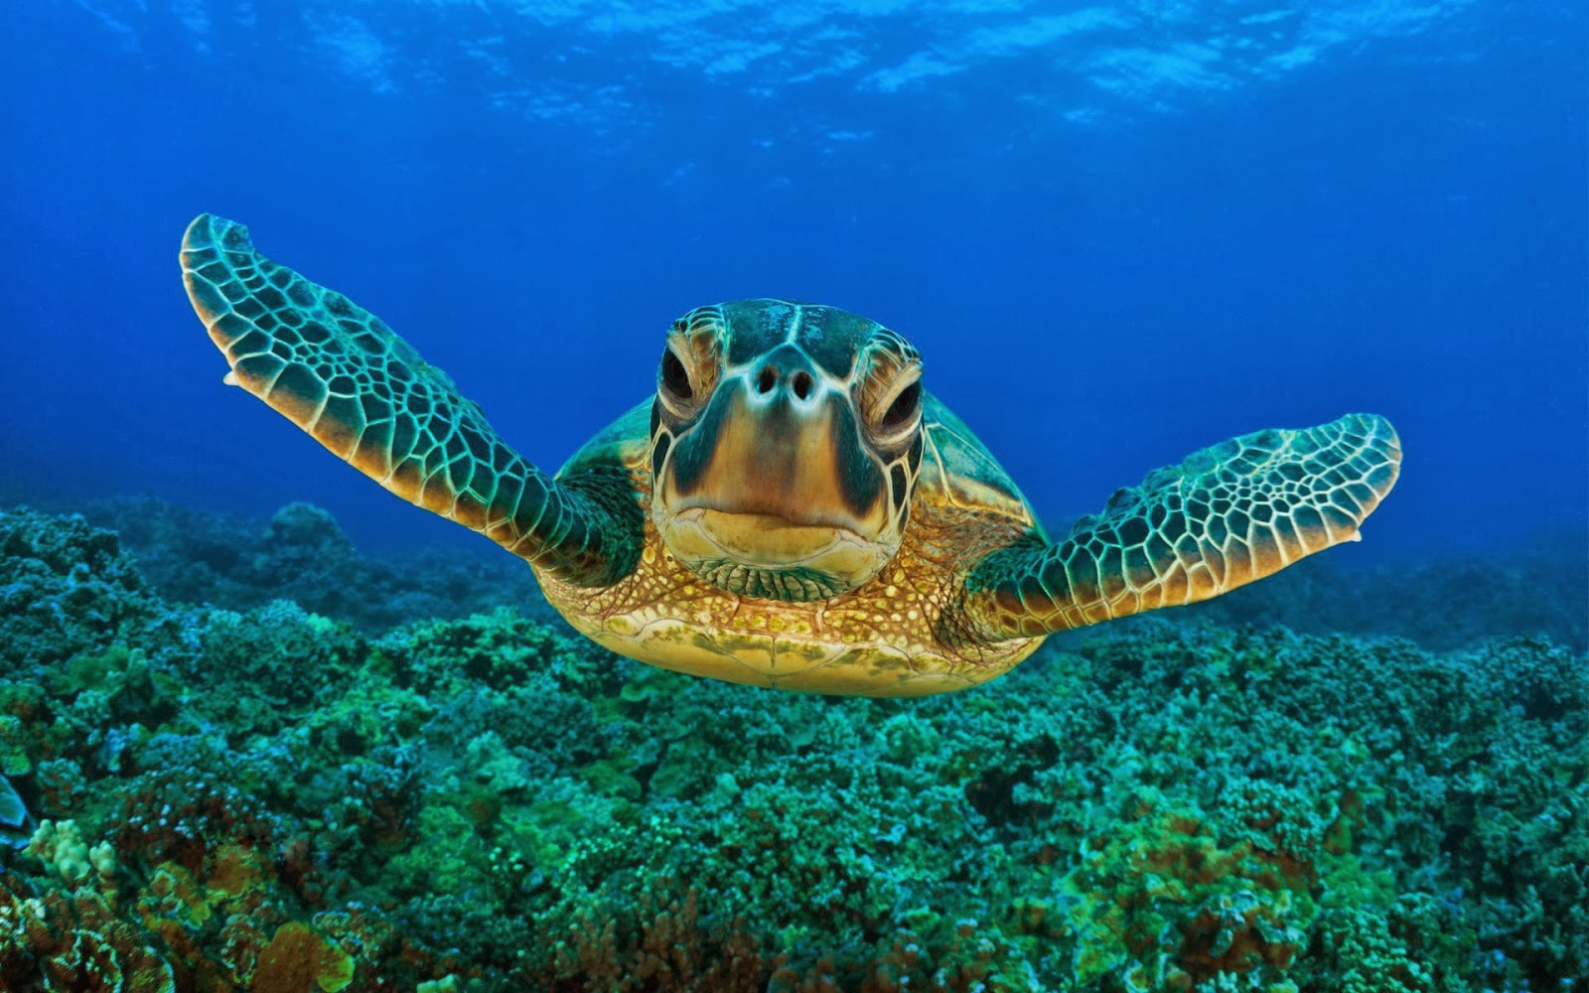

Slide 6


